Slide 1




AT82.02
Data Modeling and Management
Lab8: NEO4J - Graph Model

Slide 2
Outline
Neo4J Graph database Overview
CRUD Operations
1. CREATE
1.1 Create Node
1.2. Create many Nodes and Relationships at once.
2. QUERY
2.1 Basic Query
2.2 Make Recommendations
2.3 Aggregate
3. UPDATE
3.1 Update Property of Node or Relationship
3.2 Update Label
4. DELETE
4.1 Delete a specific node
4.2 Delete a specific relationship
4.3 Remove Label from a node
4.4 Remove a property

Slide 3
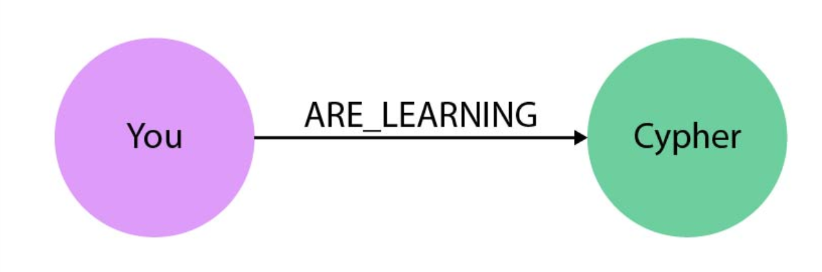


Slide 4
Neo4j is an open-source, NoSQL graph database.
Property Graph data model
Cypher Graph query language
Notes:
Neo4j, like many other graph databases, builds upon the property graph model;
labeled nodes are connected via directed, typed relationships.
Both nodes and relationships hold arbitrary properties (key-value pairs).
There is no rigid schema, but with node-labels and relationship-types we can have as much meta-information as we like.
The relationships are treated with as much value as the database records themselves.
This allows the engine to navigate your connections between nodes in constant time.
That compares favorably to the exponential slowdown of many-JOIN SQL-queries in a relational database.

Slide 5
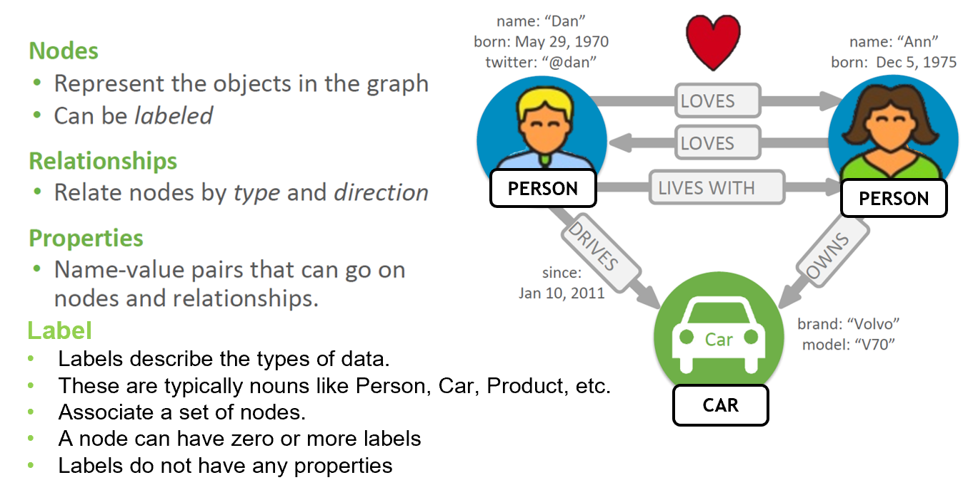
Property Graph Model

Slide 7
Cypher Query Language (CQL)
uses patterns to describe graph data
familiar SQL-like clauses
declarative, describing what to find, not how to find it

Slide 8
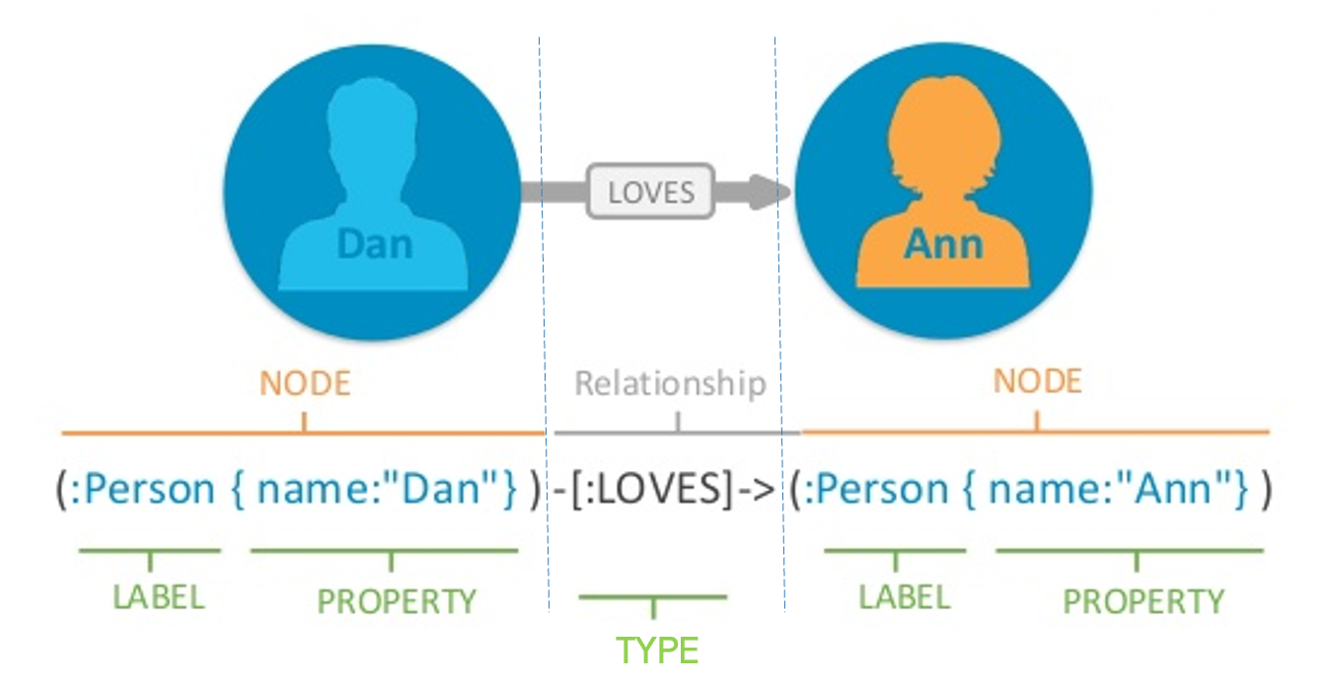
Cypher Query Language Syntax

Slide 9
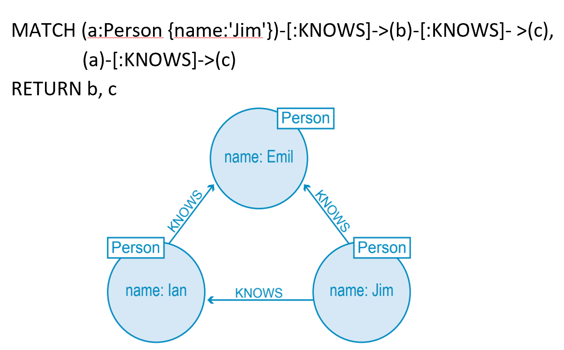
Example
Who is b?
Who is c?

Slide 10
Getting Started
Neo4j Sandbox (Demonstration)
https://sandbox.neo4j.com/

Slide 11
CRUD operations
Create/Insert
Read/Query
Update
Delete

Slide 12
Case Study: Social Network

Slide 13


{ name: “Monica”, city: “New York” }
User
REACTED
FRIEND
COMMENTED
{ message: “Yay!”, createdAt: “2021-10-11”}
{ type: “Love”, createdAt: “2021-10-11”}
{ acceptedAt: “2021-10-05”}
POSTED
User
Post
{ name: “Rachel”, city: “London” }
{ id: 9, message: “This is a message.” }

Slide 14
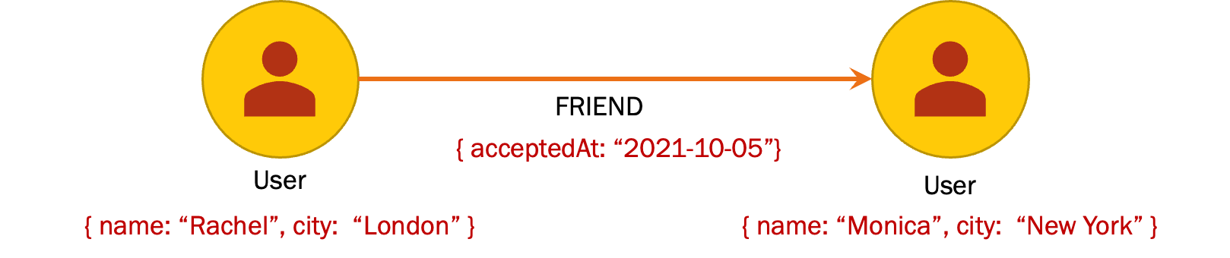
1. CREATE
Create Nodes with a relationship
CREATE (r:User { name: "Rachel", city: "London" }),
(m:User { name: "Monica", city: "New York" }),
(r)-[:FRIEND {acceptedAt:"2021-10-05"}]-> (m)

Slide 15
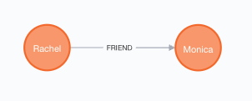
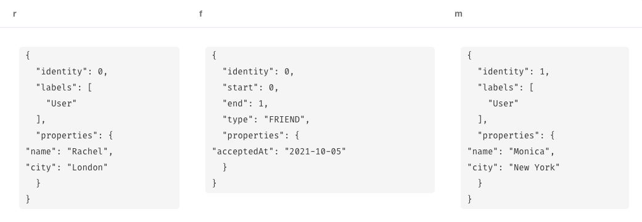
CREATE (r:User { name: "Rachel", city: "London" }),
(m:User { name: "Monica", city: "New York" }),
(r)-[f:FRIEND {acceptedAt:"2021-10-05"}]-> (m)
RETURN r,f,m
Graph View
Table View

Slide 16
Your Turn (1)
Create Cypher commands that insert two more users and make them as friends. Try add other properties than city.
Make each users you added as friends with the 2 previous users (Rachel and Monica).

Slide 17
Your Turn (1)
Create remaining nodes and relationships.
✅
✅
✅

Slide 18
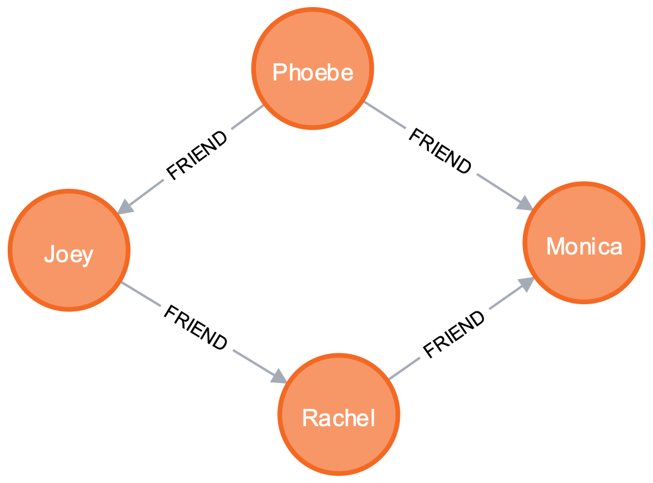
1. CREATE
Create more friendships
MATCH (r:User), (m:User),(ph:User),(j:User)
WHERE r.name="Rachel" AND m.name="Monica" AND ph.name = "Phoebe” AND j.name="Joey”
CREATE (ph)-[:FRIEND {acceptedAt: date() }]-> (m),
(j)-[:FRIEND {acceptedAt: date() }]-> (r)
RETURN r,m,ph,j;

Slide 19
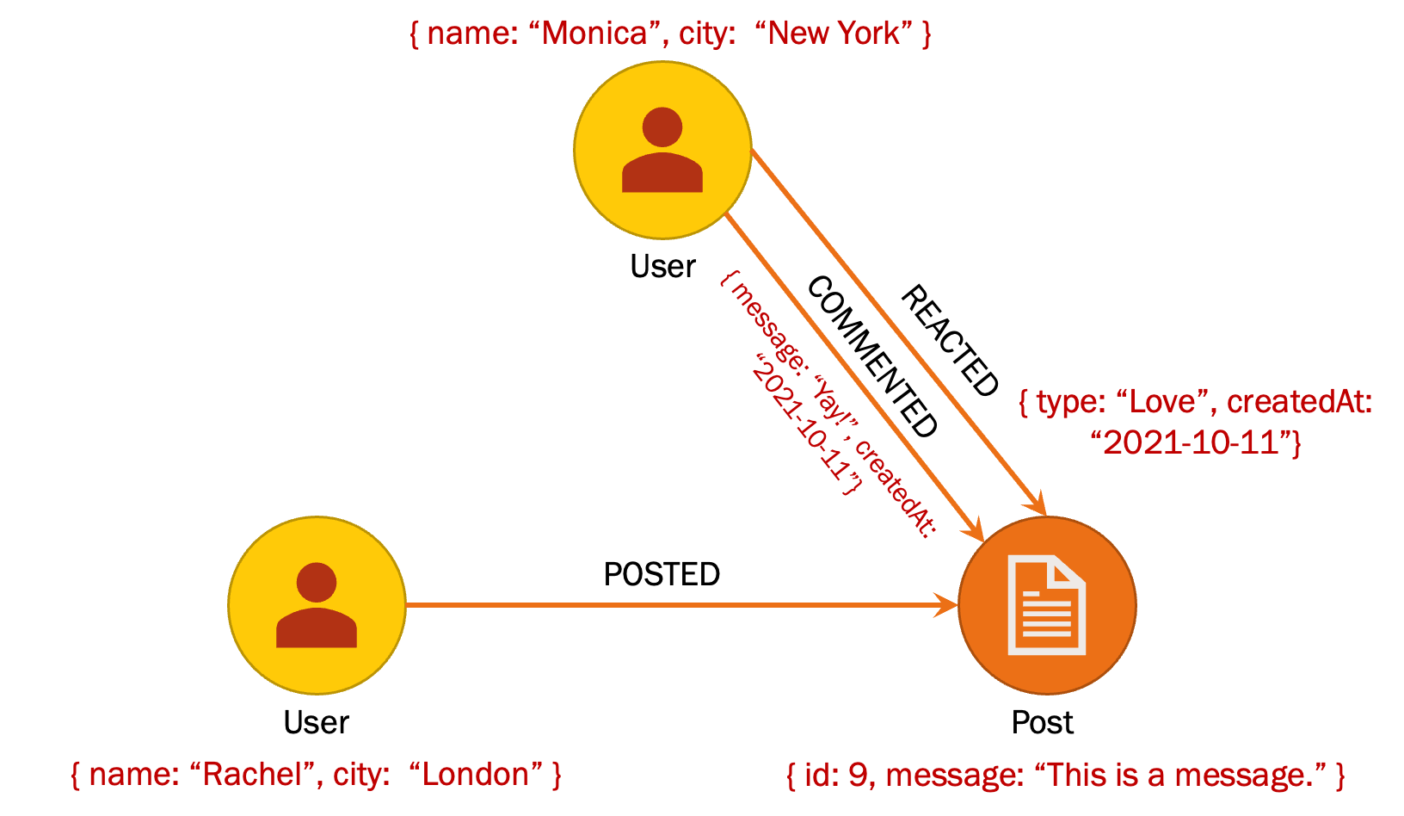
1. CREATE
Create a post , a comment and a reaction.
MATCH (r:User), (m:User)
WHERE r.name="Rachel" AND m.name="Monica"
CREATE (p:Post { id:"9", message: "This is a message." } ),
(r)-[:POSTED]->(p),
(m)-[:REACTED { type: "Love", createdAt: date() }]->(p),
(m)-[:COMMENTED { message: "Yay!", createdAt: date() }]->(p)
RETURN r,m,p;

Slide 20
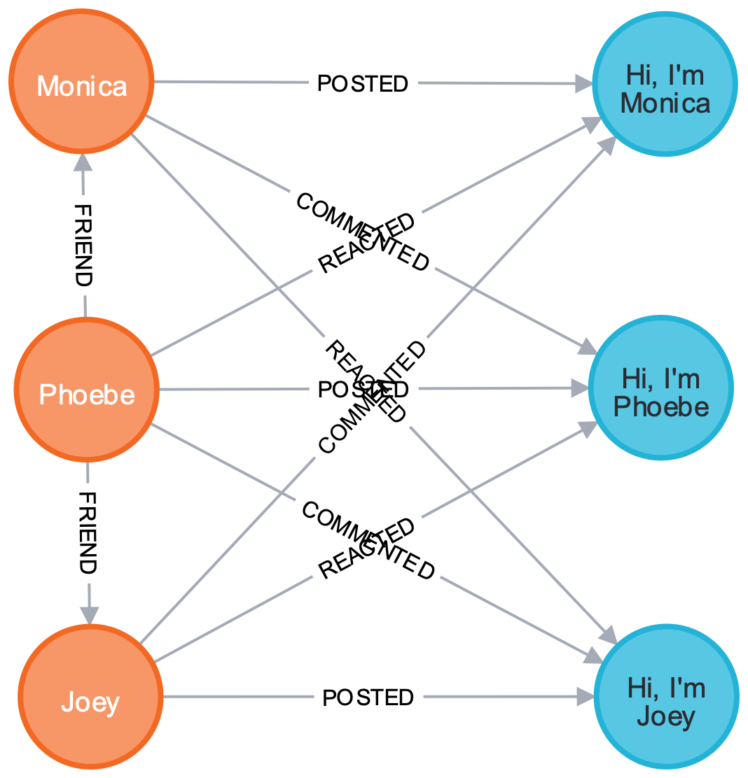
Your Turn (2)
Create 3 more posts.
Each must be posted by existing users and get at least a reaction and a comment from other users.

Slide 21
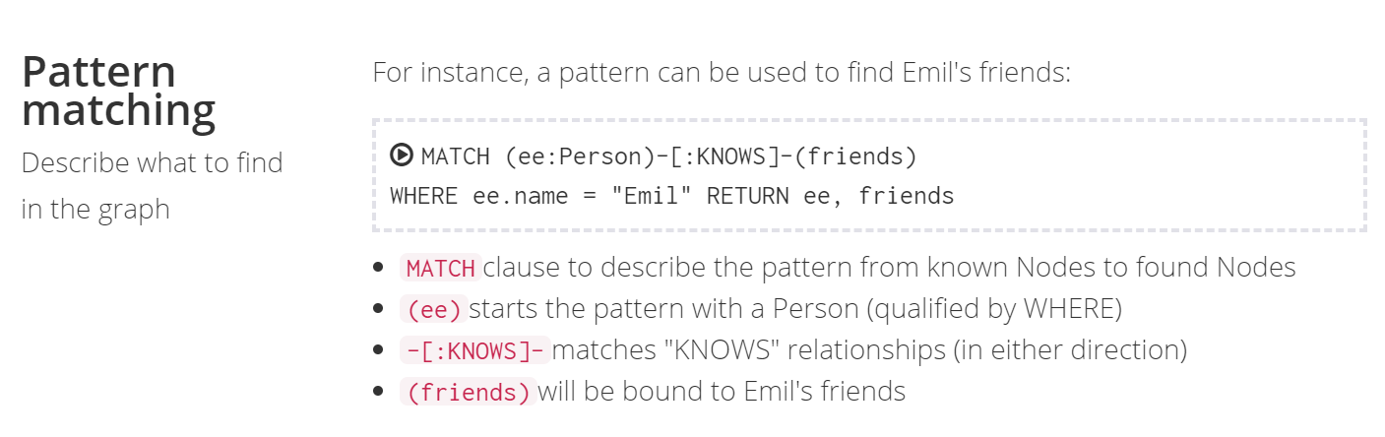
2. QUERY
2.1 Basic query the graph (Pattern matching )
EX.1 Find Emil’s Friends

Slide 22
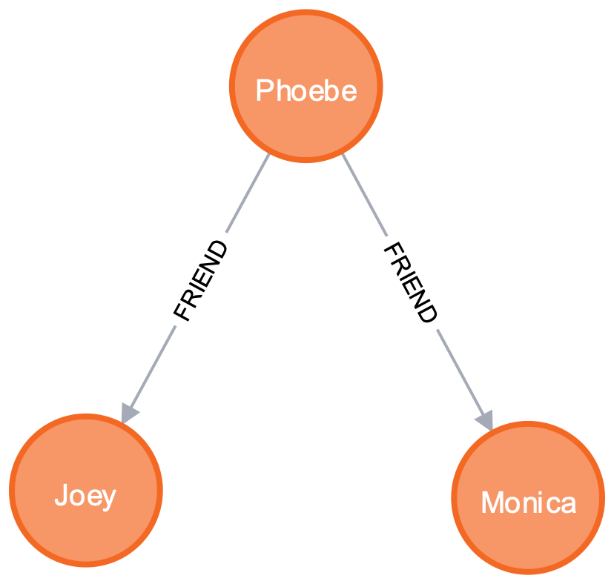
EX.2 Find Immediate Friends
MATCH (u:User)-[:FRIEND]->(f)
WHERE u.name = "Phoebe"
RETURN u,f;

Slide 23
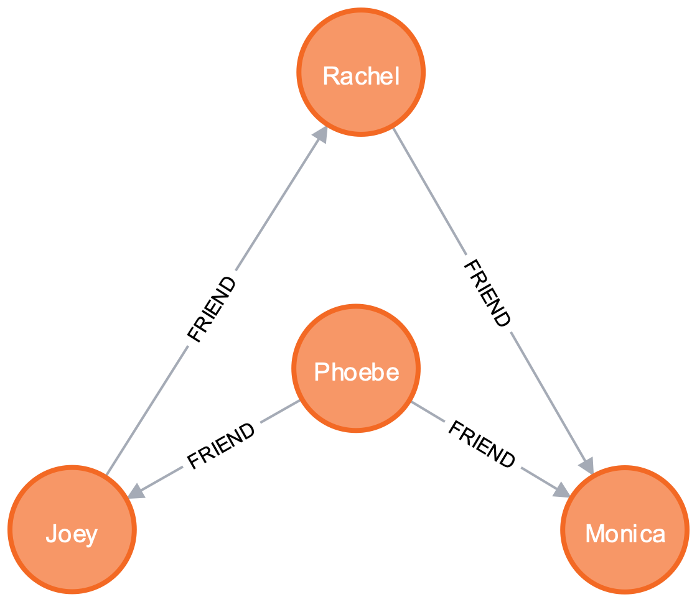
EX.3 Find Friends of Friends
MATCH (u:User)-[:FRIEND*]->(f)
WHERE u.name = "Phoebe"
RETURN u,f;

Slide 24
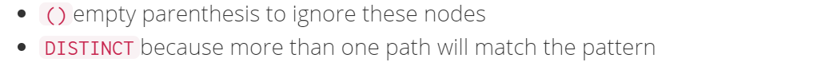
2.2 Make Recommendations (Pattern matching )
EX.4 Rachel is planning to go to Newark for a business trip, so she is looking for her friends who know someone living that city.
MATCH (r:User)-[:FRIEND]->()-[:FRIEND]-(newarkian)
WHERE r.name="Rachel" AND newarkian.city="Newark"
RETURN DISTINCT newarkian;
Notes:
MATCH (js:Person)-[:KNOWS]-()-[:KNOWS]-(surfer)
WHERE js.name = "Johan" AND surfer.hobby = "surfing"
RETURN DISTINCT surfer

Slide 25
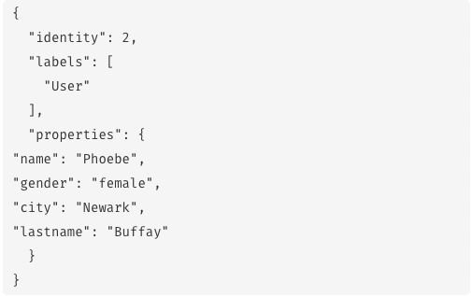
MATCH (r:User)-[:FRIEND]->()-[:FRIEND]-(newarkian)
WHERE r.name="Rachel" AND newarkian.city="Newark"
RETURN DISTINCT newarkian;

Slide 26
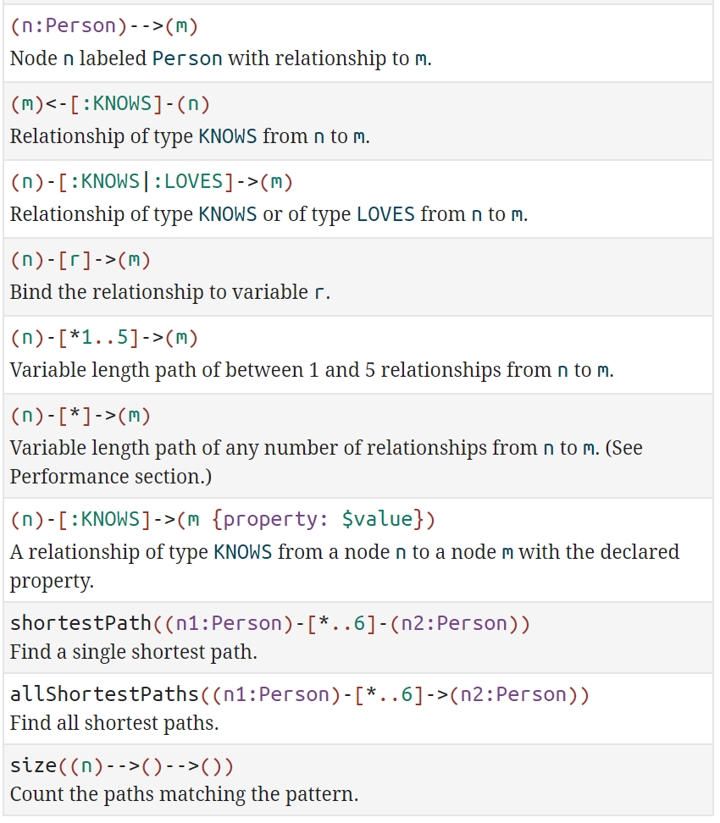
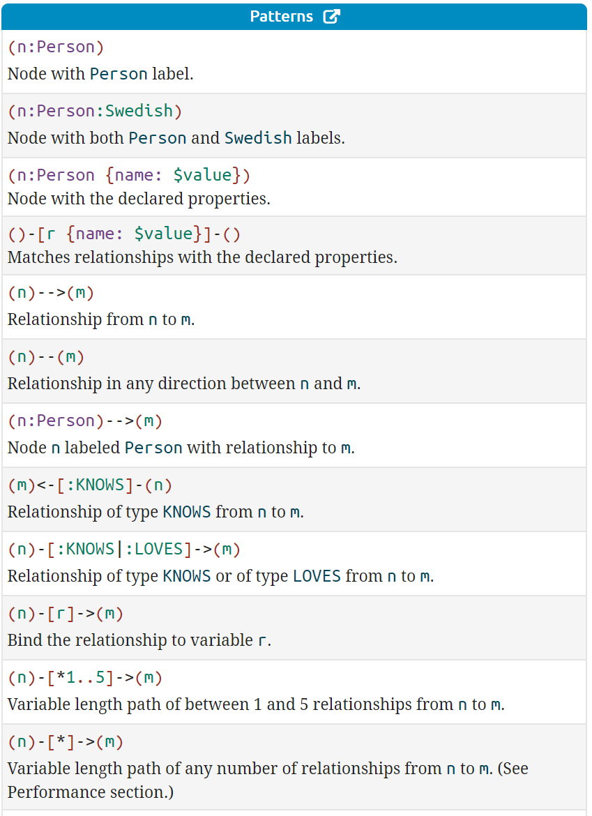
More Patterns
Notes:
https://neo4j.com/docs/cypher-refcard/current/?_ga=2.36519011.2100542366.1602562344-214533698.1600745849

Slide 27
Your Turn (3)
Find who reacted all Monica’s post.
Modify the above command to find all friends of the reactor of Monica’s post.

Slide 28
EX.5 Johan is learning to surf, so he may want to find a new friend who already does. Recommend him Only the shortestPath
MATCH (js:Person)-[:KNOWS*]->(surfer)
WHERE js.name = "Johan" AND surfer.hobby = "surfing"
MATCH path = shortestPath((js)-[:KNOWS*]->(surfer) )
RETURN surfer, path
Warning: Using shortest path with an unbounded pattern will likely result in long execution times. It is recommended to use an upper limit to the number of node hops in your pattern. So, we change to
MATCH (js:Person)-[:KNOWS*]->(surfer)
WHERE js.name = "Johan" AND surfer.hobby = "surfing"
MATCH path = shortestPath((js)-[:KNOWS*..5]->(surfer) )
RETURN surfer, path

Slide 29
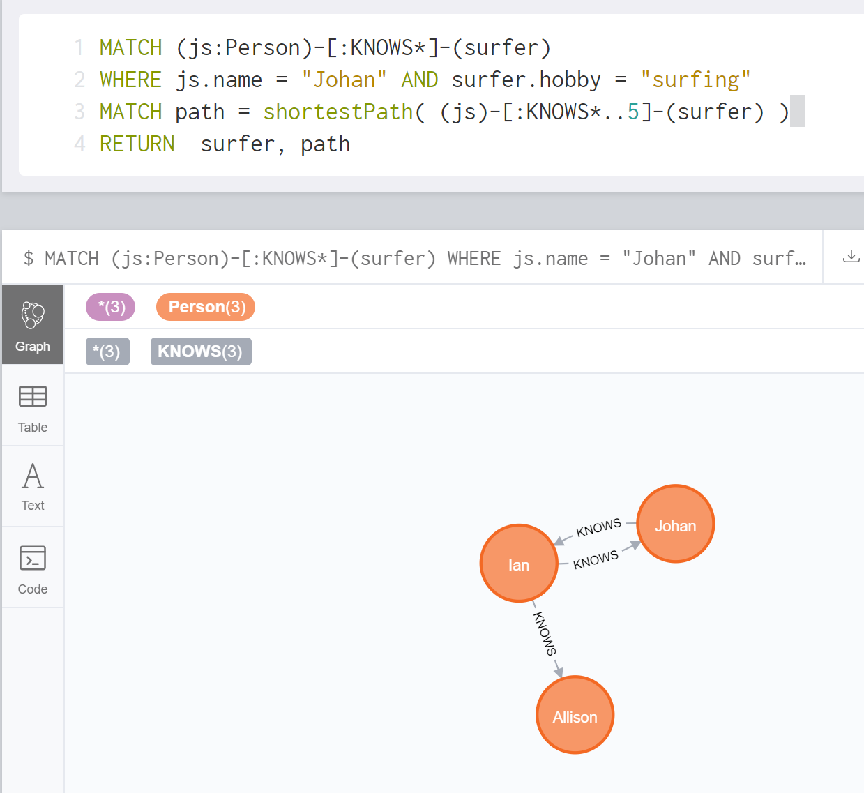

Slide 30
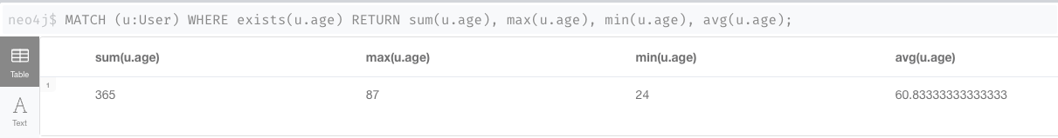
2.3 Aggregation
EX.5-1 Find total, average, minimum and maximum age of all users
MATCH (u:User) WHERE exists(u.age)
RETURN sum(u.age), max(u.age), min(u.age), avg(u.age);
Notes:
MATCH (n:Person) WHERE exists(n.age) RETURN sum(n.age),max(n.age),min(n.age),avg(n.age)

Slide 31
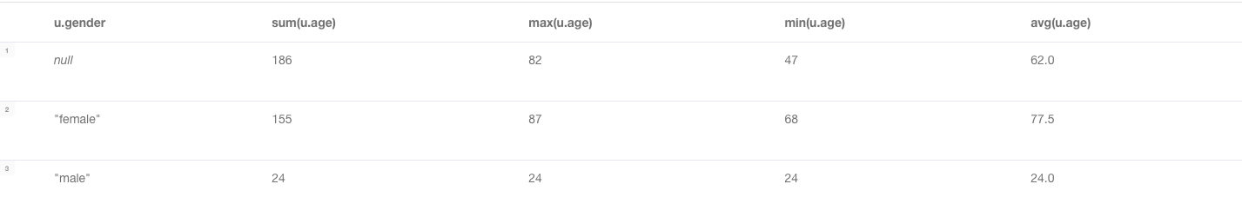
2.3 Aggregate
EX.5-2 Find Total, Average, Minimum, Maximum age of all people grouped by users’ gender.
MATCH (u:User) WHERE exists(u.age)
RETURN u.gender, sum(u.age), max(u.age), min(u.age), avg(u.age);
Notes:
MATCH (n:Person) WHERE exists(n.age) RETURN sum(n.age),max(n.age),min(n.age),avg(n.age)

Slide 32
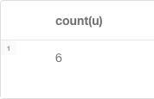
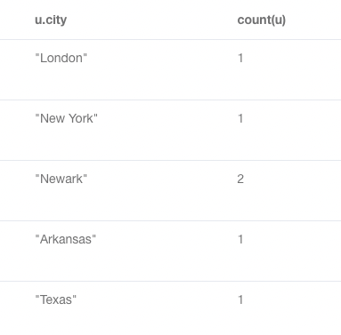
EX.6 Find total number of users
// Without a grouping key
MATCH (u:User) RETURN count(u);
// With a grouping key MATCH (u:User) RETURN u.city, count(u);
Notes:
MATCH (n:Person) WHERE exists(n.age) RETURN sum(n.age),max(n.age),min(n.age),avg(n.age)

Slide 33
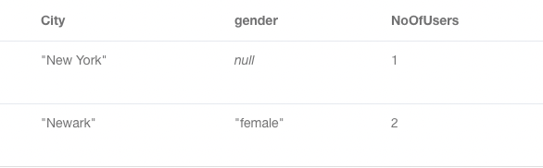
EX.7 Find Total number of persons who have pet
MATCH (u:User) WHERE u.age >=60
RETURN u.city AS City,
u.gender AS gender,
count(u) AS NoOfUsers;
Notes:
MATCH (n:Person) WHERE exists (n.pet) RETURN count(n)

Slide 34
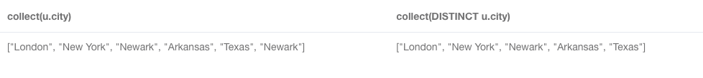
EX.8 Enumerate all cities of users
MATCH (u:User)
RETURN collect(u.city), collect(DISTINCT u.city);
Notes:
MATCH (n:Person) WHERE exists (n.pet) RETURN count(n)

Slide 35
Your Turn (4)
Count all posts grouped by each user.
List all friends’ name of each user. Show friends names in the same column.

Slide 36
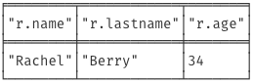
3. UPDATE
3.1 Update Node or Relationship Property
EX.9 Set Johan’s surname to be ‘Taylor’ and age =40
MATCH (r:User) WHERE r.name="Rachel"
SET r.lastname = "Berry", r.age=34
RETURN r.name, r.lastname, r.age;

Slide 37
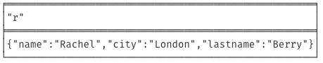
(1) If you set a property with NULL value = removing the property
EX.10 Remove Rachel’s age.
MATCH (r:User {name:"Rachel"})
SET r.age = NULL
RETURN r;

Slide 38
(2) Set mutate properties using +=
Any properties in the map that are not on the node or relationship will be added.
Any properties not in the map that are on the node or relationship will be left as is.
Any properties that are in both the map and the node or relationship will be replaced in the node or relationship.
However, if any property in the map is null, it will be removed from the node or relationship.

Slide 39
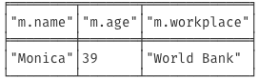
EX.11 Update Monica’s age and workplace using +=
MATCH (m:User { name: "Monica" })
SET m += { age: 39, workplace: "World Bank" }
RETURN m.name, m.age, m.workplace;

Slide 40
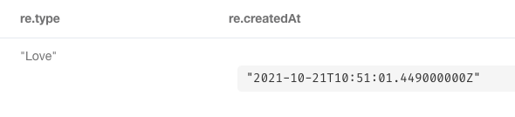
EX.12 Update Phoebe’s reaction on the Monica’s post by changing the reaction type to ‘Love’ and recording a current date-time.
MATCH (:User { name : "Phoebe's"})-[re:REACTED]->(p:Post)<- [:POSTED]-(:User { name : "Monica" })
SET re.type="Love", re.createdAt=datetime()
RETURN re.type, re.createdAt;

Slide 41
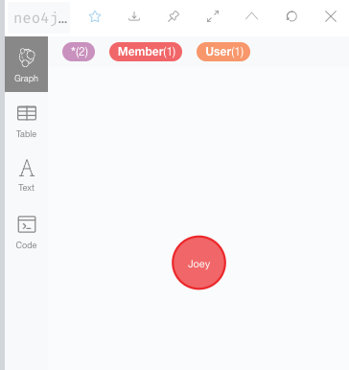
3.2 Update a node label
Use SET to set Label(s) to a node
EX.13 Update Label for Johan to be Parent and Employee
MATCH (j {name:"Joey"})
SET j:User:Member
RETURN j;

Slide 42
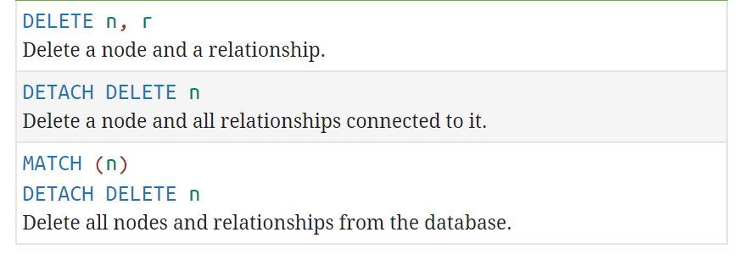
4. DELETE

Slide 43
4.1 Delete a specific node
EX.14 Delete Kim’s node
MATCH (k {name: ‘Kim'})
DETACH DELETE k;
Notes:
Verify: MATCH (n)-[r]-(m) return n,r,m

Slide 44
4.2 Delete a specific relationship
EX.15 Undo a reaction of Monica on a Joey’s post.
MATCH (m{name: 'Monica'})-[re:REACTED]->(p)<-[:POSTED]- (j{name:'Joey'})
DELETE re;
Notes:
Verify: MATCH (n)-[r]-(m) return n,r,m

Slide 45
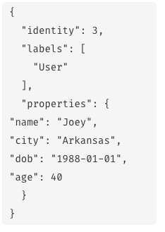
4.3 Remove Label from a node
EX.16 Remove label Member from Joey
MATCH (j {name: 'Joey'})
REMOVE j:Member
RETURN j;
Notes:
Verify: MATCH (n)-[r]-(m) return n,r,m

Slide 46
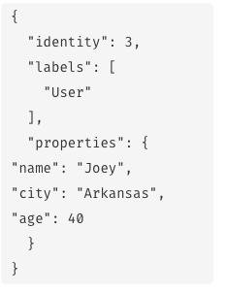
4.4 Remove a property
EX.17 Remove DOB property Joey’s node
MATCH (j {name: 'Joey'})
REMOVE j.dob
RETURN j;
Notes:
Verify: MATCH (n)-[r]-(m) return n,r,m

Slide 47
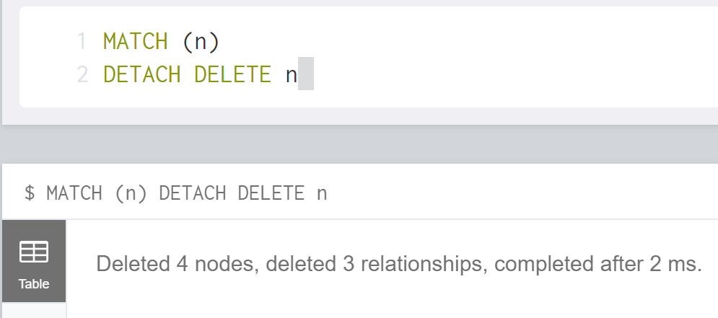
4.5 Delete ALL nodes
EX.18 Delete ALL nodes
MATCH (n)
DETACH DELETE n
Notes:
Verify: MATCH (n)-[r]-(m) return n,r,m

Slide 48
References
Migrating SQL to Cypher https://neo4j.com/developer/guide-sql-to-cypher/
Patterns Matching https://neo4j.com/docs/cypher-manual/current/syntax/patterns/
Aggregating functions https://neo4j.com/docs/cypher-manual/current/functions/aggregating/
SET property using MAP https://neo4j.com/docs/cypher-manual/current/clauses/set/#set-setting-properties-using-map

Slide 49

Thank You.

Slide 50
References
https://neo4j.com/docs/cypher-refcard/current/
https://neo4j.com/developer/
https://neo4j.com/docs/cypher-manual/current/clauses
https://neo4j.com/docs/cypher-manual/current/introduction/#cypher-introduction
https://neo4j.com/developer/guide-sql-to-cypher/

Slide 51
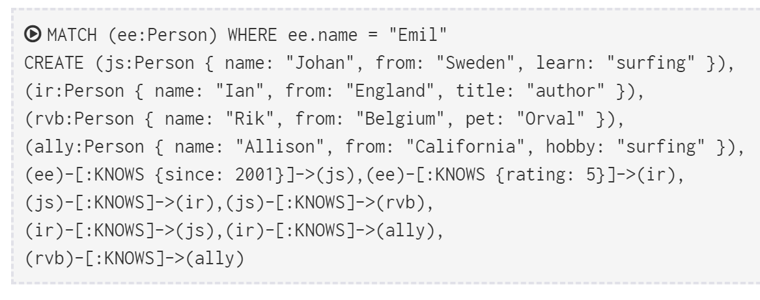
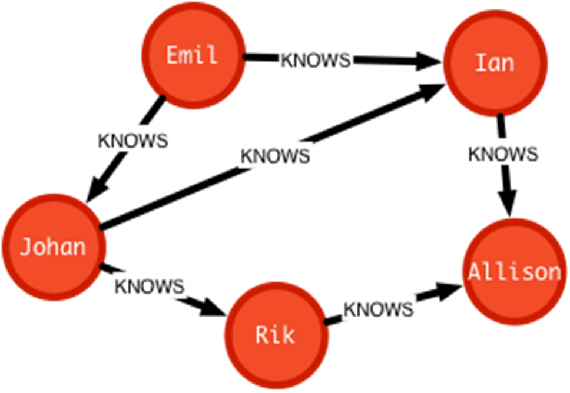
1.2. CREATE clauses can create many Nodes and Relationships at once.
MERGE
Notes:
MATCH (ee:Person) WHERE ee.name = "Emil"
CREATE (js:Person { name: "Johan", from: "Sweden", learn: "surfing" }),
(ir:Person { name: "Ian", from: "England", title: "author" }),
(rvb:Person { name: "Rik", from: "Belgium", pet: "Orval" }),
(ally:Person { name: "Allison",from: "California", hobby: "surfing" }),
(ee)-[:KNOWS {since: 2001}]->(js),(ee)-[:KNOWS {rating:5}]->(ir),
(js)-[:KNOWS]->(ir),(js)-[:KNOWS]->(rvb),
(ir)-[:KNOWS]->(js),(ir)-[:KNOWS]->(ally),
(rvb)-[:KNOWS]->(ally)

